Slide 1
Lung Cancer Update2014
Ramesh Kaul, MD MS FCCP FACP

Slide 2
Epidemiology
Lung cancer is a Global disease In 2012, there were 1.82 million new cases globally, and 1.56 million deaths due to lung cancer, representing 19.4% of all deaths from cancer. [WHO publication 2014]
North Americas, Europe much higher incidence with increase in women poulation
Lawrence County 61.5-70.7 per thousand as per CDC almost national average

Slide 3
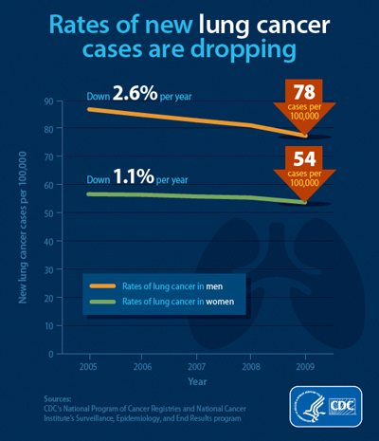
Lung Cancer January, 2014 CDC release

Slide 4
American Cancer Society Estimated New Cancer Cases by Sex and Age (Years), 2014
All ages Younger than 45 45 and Older Younger than 65 65 and Older
All sites, men 855,220 53,990 801,230 370,880 484,340
All sites, women 810,320 87,920 722,400 390,910 419,410
Colon & rectum, 71,830 3,680 68,150 30,160 41,670
men
Colon & rectum, 65,000 3,260 61,740 22,820 42,180
women
Lung & bronchus, 116,000 1,690 114,310 38,190 77,810
men
Lung & bronchus, 108,210 2,020 106,190 34,410 73,800
women
Breast, women 232,670 25,500 207,170 133,310 99,360
Prostate 233,000 1,430 231,570 98,010 134,990

Slide 5
NATIONAL CANCER INSTITUTE Press Release
Study identifies novel genomic changes in the most common type of lung cancer
Researchers from The Cancer Genome Atlas (TCGA) Research Network have identified novel mutations in a well-known cancer-causing pathway in lung adenocarcinoma, the most common subtype of lung cancer. Knowledge of these genomic changes may expand the number of possible therapeutic targets for this disease and potentially identify a greater number of patients with treatable mutations because many potent cancer drugs that target these mutations already exist.
In this new study, published online July 9, 2014, in the journal Nature, researchers examined the genomes, RNA, and some protein from 230 lung adenocarcinoma samples. In three-quarters of the samples, the scientists ultimately identified mutations that put a cell signaling pathway known as the RTK/RAS/RAF pathway into overdrive. Mutations affecting the RTK/RAS/RAF pathway can cause it to become stuck in the “on” state. As a result, signals that promote cancer cell proliferation and survival are produced continuously. However, some drugs currently available curb aberrant activity of this pathway and prompt therapeutic responses in patients.

Slide 6
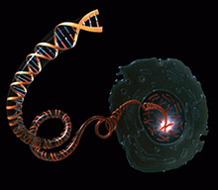
The researchers also identified mutations in other genes—including NF1 and RIT1, part of the RTK/RAS/RAF pathway—that can drive lung adenocarcinomas. By analyzing DNA, RNA, and protein levels, the team determined that several metabolic pathways were activated in the tumor samples. Overall, 76% of the samples had mutations that activate the RTK/RAS/RAF pathway. This work may lead to refinements in how cancers are classified and could lead to more personalized diagnosis and treatment.
In 143 out of 230 samples (62%), the researchers found known activating mutations (misspellings) in oncogenes—genes known to have the potential to cause cancer when mutated or expressed at high level. To identify additional alterations, the investigators looked at DNA copy number changes—changes in gene number from the deletion or multiplication (amplification) of sections of DNA. They detected amplification of 2 oncogenes, ERBB2 and MET, that are part of a signaling pathway known as RTK/RAS/RAF. These mutations cause the pathway to become stuck in the “on” state, triggering tumor cell growth and survival.

Slide 7
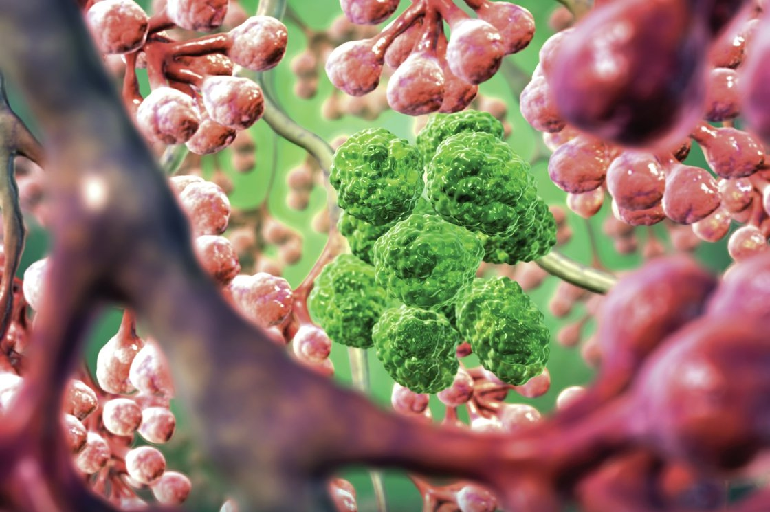
Lung Cancer in Bunch of Air Sacs

Slide 8
Clinical Guidelines | 4 March 2014 Screening for Lung Cancer: U.S. Preventive Services Task Force Recommendation Statement
The USPSTF recommends annual screening for lung cancer with low-dose computed tomography (LDCT) in adults aged 55 to 80 years who have a 30 pack-year smoking history and currently smoke or have quit within the past 15 years. Screening should be discontinued once a person has not smoked for 15 years or develops a health problem that substantially limits life expectancy or the ability or willingness to have curative lung surgery. (B recommendation)

Slide 9
Lung nodules
INTERPRETATION:
Small nodules (those with a volume <100 mm3 or diameter <5 mm) are not predictive for lung cancer. Immediate diagnostic evaluation is necessary for large nodules (≥300 mm3 or ≥10 mm). Volume doubling time assessment is advocated only for intermediate-sized nodules (with a volume ranging between 100-300 mm3 or diameter of 5-10 mm). Nodule management protocols based on these thresholds performed better than the simulated ACCP nodule protocol.
Ground Glass Nodules
Solid Nodules
Semi solid Nodules
Spiculated Nodules
Pop corn Calcified Nodules
Fully calcified Nodules
Cystic Nodules
Cavitary Nodules

Slide 10
Fine-needle aspiration (FNA) biopsy of the lung: The removal of tissue or fluid from the lung, using a thin needle. A CT scan, ultrasound, or other imaging procedure is used to find the abnormal tissue or fluid in the lung. A small incision may be made in the skin where the biopsy needle is inserted into the abnormal tissue or fluid. A sample is removed with the needle and sent to the laboratory. A pathologist then views the sample under a microscope to look for cancer cells. A chest x-ray is done after the procedure to make sure no air is leaking from the lung into the chest.

Slide 11
Super Dimensional Electromagnetic Navigational Bronchoscopy

Slide 12
Super Dimensional Electromagnetic Navigational Bronchoscopy

Slide 13
Types of Lung cancer
NSCLS Squamous
Adenocarcinoma
Mixed Poorly Differentiated
Broncho alveolar NSCLC
Large Cell NSCLC
Carcinoid
SCLC

Slide 14
Stages of NSCLC
Occult (hidden) stage
Stage 0 (carcinoma in situ)
Stage I
Stage II
Stage IIIA
Stage IIIB
Stage IV

Slide 15
Lung Cancer. 2014 Sep 16. pii: S0169-5002(14)00373-0. doi: 10.1016/j.lungcan.2014.09.006. [Epub ahead of print]
Prognostic evaluations of small size lung cancers by 18F-FDG PET/CT and thin-section CT.
Kishimoto M1, Iwano S2, Ito S1, Kato K3, Ito R1, Naganawa S
MATERIALS AND METHODS:
Clinical records, post-operative pathologic findings, and pre-operative PET/CT and TSCT images were reviewed. Solitary primary lung cancers of ≤3cm in diameter after surgical resection were selected for analysis. SUVmax and C/T ratios were recorded. Kaplan-Meier survival curves and Cox hazards ratios were used to identify independent predictors of lung cancer recurrence from among age, gender, surgical procedure, lesion size, C/T ratio, and SUVmax.
RESULTS:
A total of 169 patients (114 males and 55 females; age range: 34-87 years) with solitary lung cancers were evaluated. The median post-operative follow-up period was 42 months. Twenty-eight patients had cancer recurrence with significantly higher SUVmax (p<0.001) and C/T ratios (p<0.001) than patients without recurrence. Disease-free survival was significantly reduced for SUVmax of ≥2.5 vs. SUVmax of <2.5 (p<0.001) or for a C/T ratio of ≥50% vs. a C/T ratio of <50% (p=0.030). For 19 patients with C/T ratios of <50%, none had a post-operative recurrence. A Cox hazards ratio model showed that only SUVmax was an independent predictor of recurrence (hazards ratio=1.324; p<0.001).
CONCLUSION:
SUVmax on FDG-PET/CT was a significant imaging biomarker relevant to the prognosis of patients with lung cancers, and was superior to the C/T ratio on TSCT for predicting postoperative recurrence, particularly for solid type lung cancer.

Slide 16
Endoscopic ultrasound (EUS): A procedure in which an endoscope is inserted into the body. An endoscope is a thin, tube-like instrument with a light and a lens for viewing. A probe at the end of the endoscope is used to bounce high-energy sound waves (ultrasound) off internal tissues or organs and make echoes. The echoes form a picture of body tissues called a sonogram. This procedure is also called endosonography. EUS may be used to guide fine needle aspiration (FNA) biopsy of the lung, lymph nodes, or other areas.

Slide 17
Stage 0 (Carcinoma in Situ)
Treatment of stage 0 may include the following:
Surgery (wedge resection or segmental resection).
Photodynamic therapy using an endoscope.
Electrocautery, cryosurgery, or laser surgery using an endoscope.

Slide 18
Mediastinoscopy : A surgical procedure to look at the organs, tissues, and lymph nodes between the lungs for abnormal areas. An incision (cut) is made at the top of the breastbone and a mediastinoscope is inserted into the chest. A mediastinoscope is a thin, tube-like instrument with a light and a lens for viewing. It may also have a tool to remove tissue or lymph node samples, which are checked under a microscope for signs of cancer.

Slide 19
n stage I, cancer has formed. Stage I is divided into stages IA and IB: Stage IA: The tumor is in the lung only and is 3 centimeters or smaller. Stage IB: Cancer has not spread to the lymph nodes and one or more of the following is true: The tumor is larger than 3 centimeters but not larger than 5 centimeters. Cancer has spread to the main bronchus and is at least 2 centimeters below where the trachea joins the bronchus. Cancer has spread to the innermost layer of the membrane that covers the lung. Part of the lung has collapsed or developed pneumonitis (inflammation of the lung) in the area where the trachea joins the bronchus.

Slide 20
Stage I Non-Small Cell Lung Cancer
Treatment of stage I non-small cell lung cancer may include the following:
Surgery (wedge resection, segmental resection, sleeve resection, or lobectomy).
External radiation therapy (for patients who cannot have surgery or choose not to have surgery).
A clinical trial of chemotherapy or radiation therapy following surgery.
A clinical trial of surgery followed by chemoprevention.
A clinical trial of treatment given through an endoscope, such as photodynamic therapy (PDT).

Slide 21
Stage IIA non-small cell lung cancer. Cancer has spread to certain lymph nodes on the same side of the chest as the primary tumor; the cancer is (a) 5 cm or smaller, (b) has spread to the main bronchus, and/or (c) has spread to the innermost layer of the lung lining. OR, cancer has not spread to lymph nodes; the cancer is (d) larger than 5 cm but not larger than 7 cm, (e) has spread to the main bronchus, and/or (f) has spread to the innermost layer of the lung lining. Part of the lung may have collapsed or become inflamed (not shown)

Slide 22
Stage IIB non-small cell lung cancer. Cancer has spread to certain lymph nodes on the same side of the chest as the primary tumor; the cancer is (a) larger than 5 cm but not larger than 7 cm, (b) has spread to the main bronchus, and/or (c) has spread to the innermost layer of the lung lining. Part of the lung may have collapsed or become inflamed (not shown). OR, (d) the cancer is larger than 7 cm; (e) has spread to the main bronchus, (f) the diaphragm, (g) the chest wall or the lining of the chest wall; and/or (h) has spread to the membrane around the heart. There may be one or more separate tumors in the same lobe of the lung; cancer may have spread to the nerve that controls the diaphragm; the whole lung may have collapsed or become inflamed (not shown)

Slide 23
Stage II Non-Small Cell Lung Cancer
Treatment of stage II non-small cell lung cancer may include the following:
Surgery (wedge resection, segmental resection, sleeve resection, lobectomy, or pneumonectomy).
Chemotherapy followed by surgery.
Surgery followed by chemotherapy.
External radiation therapy (for patients who cannot have surgery or choose not to have surgery).
A clinical trial of radiation therapy following surgery.

Slide 24
Stage IIIA non-small cell lung cancer (1). Cancer has spread to certain lymph nodes on the same side of the chest as the primary tumor. The cancer may have spread to (a) the main bronchus; (b) lung lining, chest wall lining, or chest wall; (c) diaphragm; and/or (d) membrane around the heart; and/or (e) there may be one or more separate tumors in the same lobe of the lung. Cancer may have spread to the nerve that controls the diaphragm, and part or all of the lung may have collapsed or become inflamed (not shown).

Slide 25
Stage IIIA Non-Small Cell Lung Cancer
Treatment of stage IIIA non-small cell lung cancer that can be removed with surgery may include the following:
Surgery followed by chemotherapy.
Chemotherapy followed by surgery.
Surgery followed by chemotherapy combined with radiation therapy.
Surgery followed by radiation therapy. Chemotherapy and radiation therapy given as separate treatments over the same period of time.
External radiation therapy alone (for patients who cannot be treated with combined therapy, as palliative treatment to relieve symptoms and improve the quality of life).
Internal radiation therapy or laser surgery, as palliative treatment to relieve symptoms and improve the quality of life.

Slide 26
Stage IIIA lung cancer (2). Cancer has spread to certain lymph nodes on the same side of the chest as the primary tumor. The cancer may have spread to (a) the main bronchus; (b) the lung lining, chest wall lining, or chest wall; (c) diaphragm; (d) heart and/or membrane around the it; (e) major blood vessels that lead to or from the heart; (f) trachea; (g) esophagus; (h) sternum; and/or (i) carina; and/or (j) there may be one or more separate tumors in any lobe of the same lung. Cancer may have spread to the nerves that control the diaphragm and larynx, and the whole lung may have collapsed or become inflamed (not shown).

Slide 27
Eur J Cancer. 2014 Sep 30. pii: S0959-8049(14)00941-1. doi: 10.1016/j.ejca.2014.09.006. [Epub ahead of print]
Comparison of long-term survival outcomes between stereotactic body radiotherapy and sublobar resection for stage I non-small-cell lung cancer in patients at high risk for lobectomy: A propensity score matching analysis.
Matsuo Y1, Chen F2, Hamaji M2, Kawaguchi A3, Ueki N4, Nagata Y5, Sonobe M2, Morita S3, Date H2, Hiraoka M4.
Author information
RESULTS:
One hundred and fifteen patients who underwent SBRT and 65 SLR were enrolled. The median potential follow-up periods for SBRT and SLR were 6.7 and 5.3years, respectively. No treatment-related deaths were observed. Before PSM, the 5-year overall survival (OS) was 40.3% and 60.5% for SBRT and SLR, respectively (P=0.008). PSM identified 53 patients from each treatment group with similar characteristics: a median age of 76years, a performance status of 0-1, a median tumour diameter of ∼20mm, a median FEV1 of ∼1.8L and a median CCI of 1. The difference in OS became insignificant between the matched pairs (40.4% and 55.6% at 5years with SBRT and SLR; P=0.124). The cumulative incidence of cause-specific death was comparable between groups (35.3% and 30.3% at 5years, P=0.427).
CONCLUSION:
SBRT can be an alternative treatment option to SLR for patients who cannot tolerate lobectomy because of medical comorbidities.

Slide 28
Stage IIIA non-small cell lung cancer (3). Cancer has spread to (a) the heart; (b) major blood vessels that lead to or from the heart; (c) trachea; (d) esophagus; (e) sternum; and/or (f) carina. Cancer may have spread to the nerve that controls the larynx (not shown)

Slide 29
Some stage IIIA non-small cell lung tumors that have grown into the chest wall may be completely removed. Treatment of chest wall tumors may include the following:
Surgery.
Surgery and radiation therapy.
Radiation therapy alone.
Chemotherapy combined with radiation therapy and/or surgery.

Slide 30
Stage IIIB non-small cell lung cancer (1). Cancer has spread to lymph nodes above the collarbone or on the opposite side of the chest as the primary tumor. The cancer may have spread to (a) the main bronchus; (b) lung lining, chest wall lining, or chest wall; (c) diaphragm; (d) heart or the membrane around it; (e) major blood vessels that lead to or from the heart; (f) trachea; (g) esophagus; (h) sternum; and/or (i) carina; and/or (j) there may be one or more separate tumors in any of the lobes of the lung. Part or all of the lung may have collapsed or become inflamed and cancer may have spread to the backbone and/or the nerves that control the diaphragm and larynx (not shown).

Slide 31
Age and pneumonectomy
CONCLUSION:
Selection criteria for octogenarians are similar to those applied in the rest of the population. Advanced age is not a factor for increased 30-day mortality or postoperative morbidity.

Slide 32
Stage IIIB Non-Small Cell Lung Cancer
Treatment of stage IIIB non-small cell lung cancer may include the following:
Chemotherapy followed by external radiation therapy.
Chemotherapy and radiation therapy given as separate treatments over the same period of time.
Chemotherapy followed by surgery.
External radiation therapy alone for patients who cannot be treated with chemotherapy.
External or internal radiation therapy as palliative therapy, to relieve pain and other symptoms and improve the quality of life.
Clinical trials of new radiation therapy schedules and new combinations of treatments.

Slide 33
Stage IIIB non-small cell lung cancer (2). Cancer has spread to certain lymph nodes on the same side of the chest as the primary tumor and to (a) the heart; (b) major blood vessels that lead to or from the heart; (c) trachea; (d) esophagus; (e) sternum; and/or (f) carina; and/or (g) there may be separate tumors in different lobes of the same lung. Cancer may have spread to the backbone and/or the nerve that controls the larynx (not shown).

Slide 34
Non-small cell lung cancer of the superior sulcus, often called Pancoast tumor, begins in the upper part of the lung and spreads to nearby tissues such as the ribs and vertebrae. Treatment of Pancoast tumors may include the following:
Radiation therapy alone.
Radiation therapy followed by surgery.
Chemotherapy and radiation therapy given as separate treatments over the same period of time, followed by surgery.
Surgery alone.
A clinical trial of new combinations of treatments.

Slide 35
Stage IV non-small cell lung cancer. The cancer has spread to the other lung, and/or to lymph nodes, fluid around the lungs or heart, and/or other places in the body, such as the brain, liver, adrenal glands, kidneys, or bones.

Slide 36
Stage IV Non-Small Cell Lung Cancer
Treatment of stage IV non-small cell lung cancer may include the following:
Combination chemotherapy.
Maintenance therapy with an anticancer drug to help keep cancer from progressing, after combination chemotherapy.
Combination chemotherapy and targeted therapy with a monoclonal antibody, such as bevacizumab or cetuximab.
Targeted therapy with a small-molecule tyrosine kinase inhibitor, such as erlotinib or crizotinib.
External radiation therapy as palliative therapy, to relieve pain and other symptoms and improve the quality of life.
Laser therapy and/or internal radiation therapy.
A clinical trial of new drugs and combinations of treatments.

Slide 37
Cardiopulmonary Syndrome Overview
Cardiopulmonary syndromes are conditions of the heart and lung that may be caused by cancer or by other health problems. Five cardiopulmonary syndromes that may be caused by cancer are covered in this summary:
Dyspnea (shortness of breath).
Chronic cough.
Malignant pleural effusion (extra fluid around the lungs).
Malignant pericardial effusion (extra fluid in the sac around the heart).
Superior vena cava syndrome (a blocked superior vena cava, the large vein that takes blood back to the heart).

